Slide 1
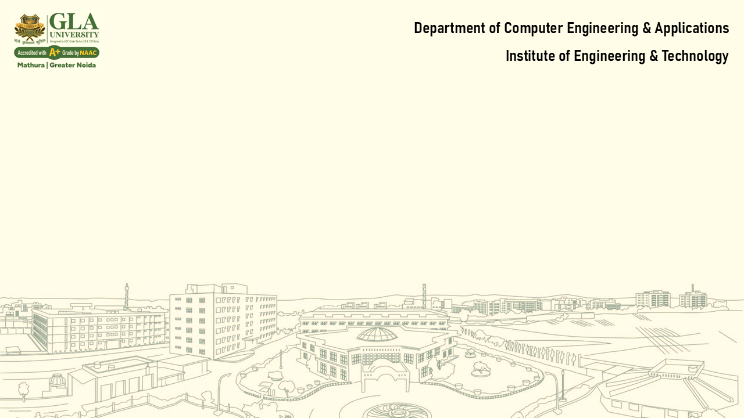
Lecture-6
File & I/O Management + OS Security
Core Topics:
File System Interface and Implementation
Directory Structure, File Allocation Methods
Disk Scheduling Algorithms
OS Security: Authentication, Access Control, Threats

Slide 2

Operating System
File System Interface and Implementation
The file system provides a way to store and retrieve data and programs.
It includes file attributes, operations, and the logical structure of files.
File attributes-Name, Type, Size, Permissions, Timestamps, Location, Protection, Time, Date and User identification.
File operations-Create, Read, Write, Delete, Seek.
File types-Text, Binary, Directory, etc

Slide 3
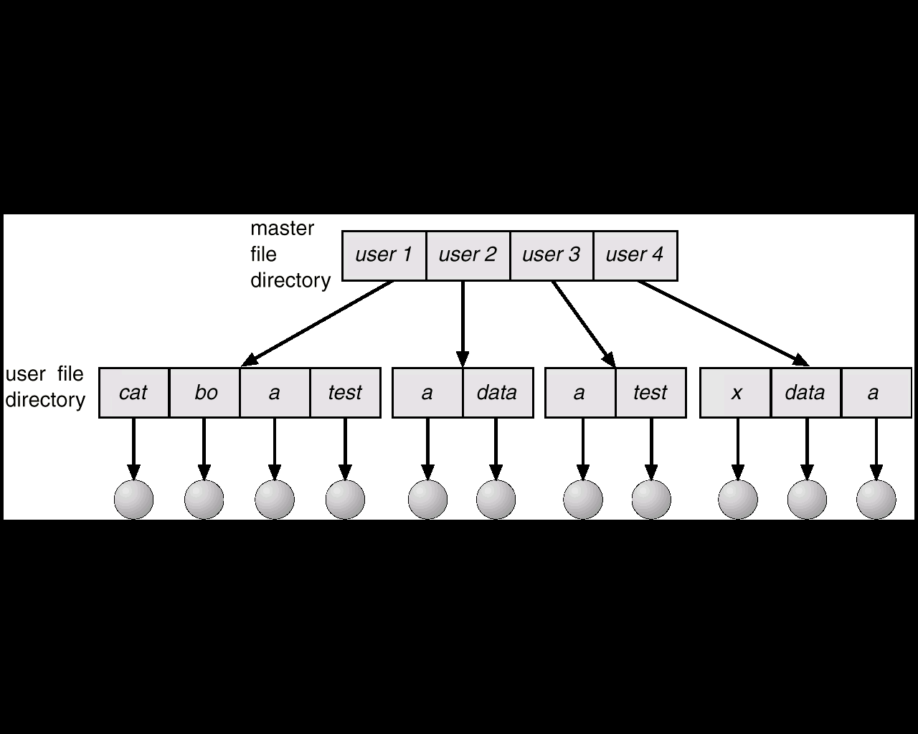
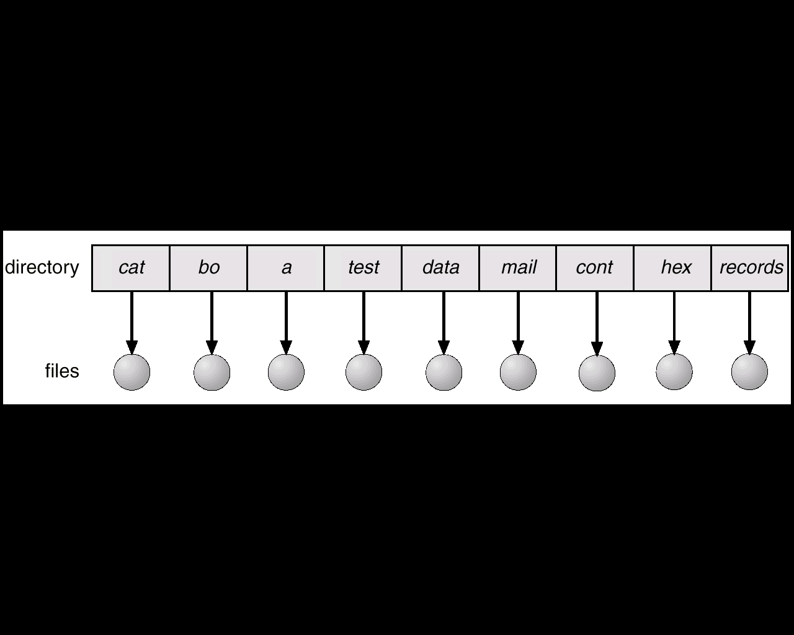
1. Single Level Directory
Operating System
Directory Structure
A collection of nodes containing information about all files.
Directory structure contains Single Level Directory, Two Level Directory, Tree Structured Directories and Acyclic Graph Directories.
Single Level- All files in the same directory.
Two Level Directory-Separate directory for each user.
Tree Structured Directories-Tree Hierarchical structure with directories and subdirectories.
Acyclic Graph Directories-Acyclic Graph Allows shared subdirectories or files.
2. Two Level Directory

Slide 4
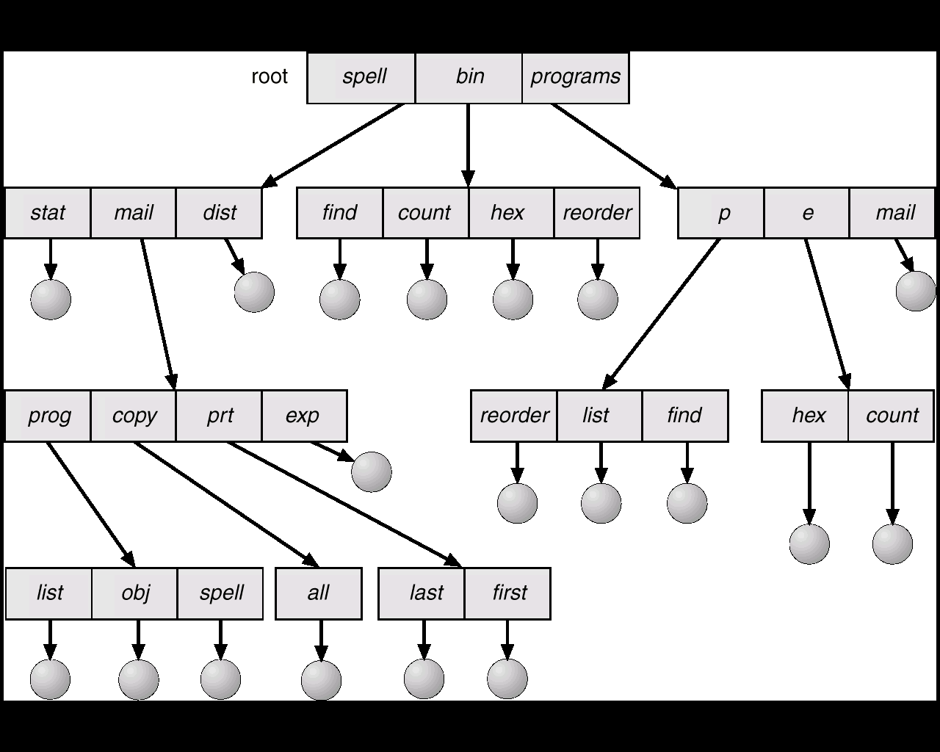
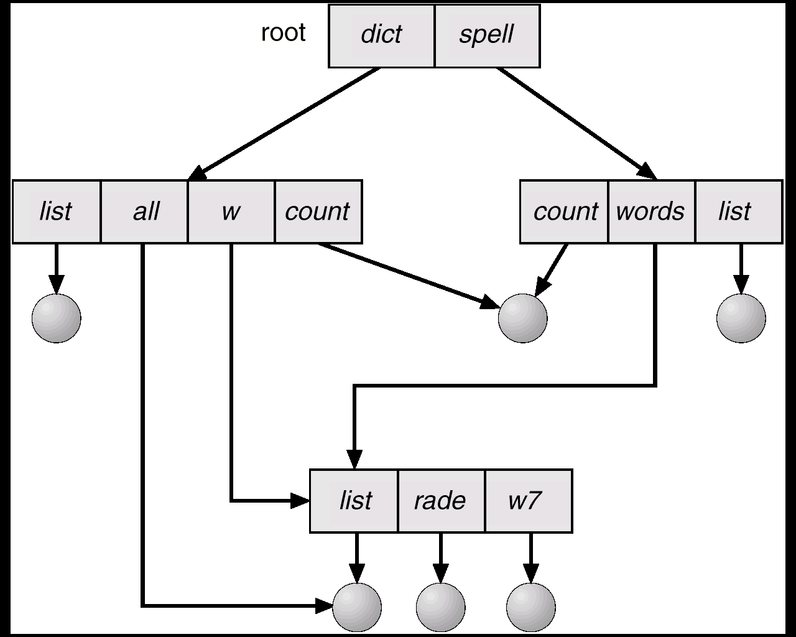
3. Tree Structured Directories
Operating System
Directory Structure
4. Acyclic Graph Directories

Slide 5
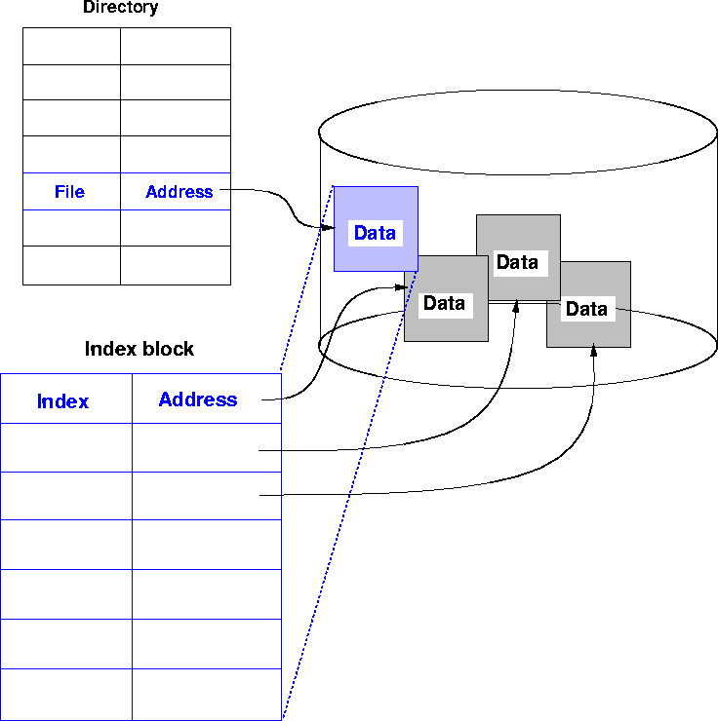
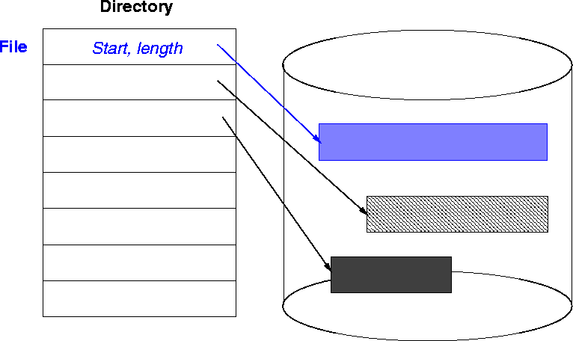
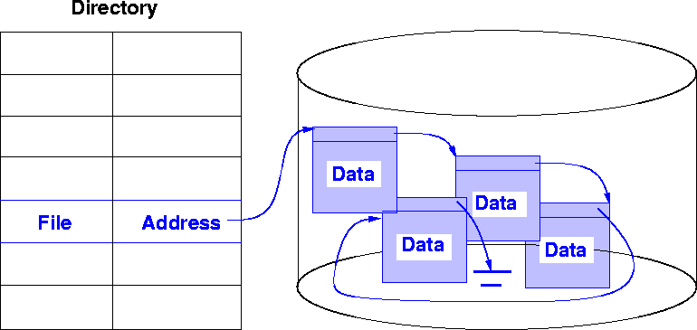
1. Contiguous Allocation
Operating System
File Allocation Methods
File allocation methods determine how an operating system stores files on a storage device, like a hard disk, to ensure efficient space usage and quick access.
Types of file allocation methods are contiguous, linked and indexed.
Contiguous-Each file occupies a set of contiguous blocks on disk.
Linked-Each block contains a pointer to the next block.
Indexed-Uses an index block to keep pointers to all file blocks.
3. Indexed Allocation
2. Linked Allocation

Slide 6
Operating System
Disk Scheduling Algorithms
Disk scheduling algorithms are used by operating systems to manage the order in which disk I/O requests are processed. Different types are FIFO, SSTF, SCAN, C-SCAN, LOOK and C-LOOK.
First In First Out (FIFO)-Serve requests in order of arrival.
Shortest Seek Time First (SSTF)-Selects the request closest to current head position.
SCAN-Moves head from one end to other, servicing in one direction.
C-SCAN-Only services requests in one direction then resets.
LOOK-scanning the disk in a specific direction, but instead of going to the end of the disk, it reverses direction as soon as it reaches the last request in the current direction.
C-LOOK-It works by moving the disk head in one direction until the last request in that direction is serviced, then reversing and moving to the first request in the opposite direction, without servicing requests on the return trip.

Slide 7
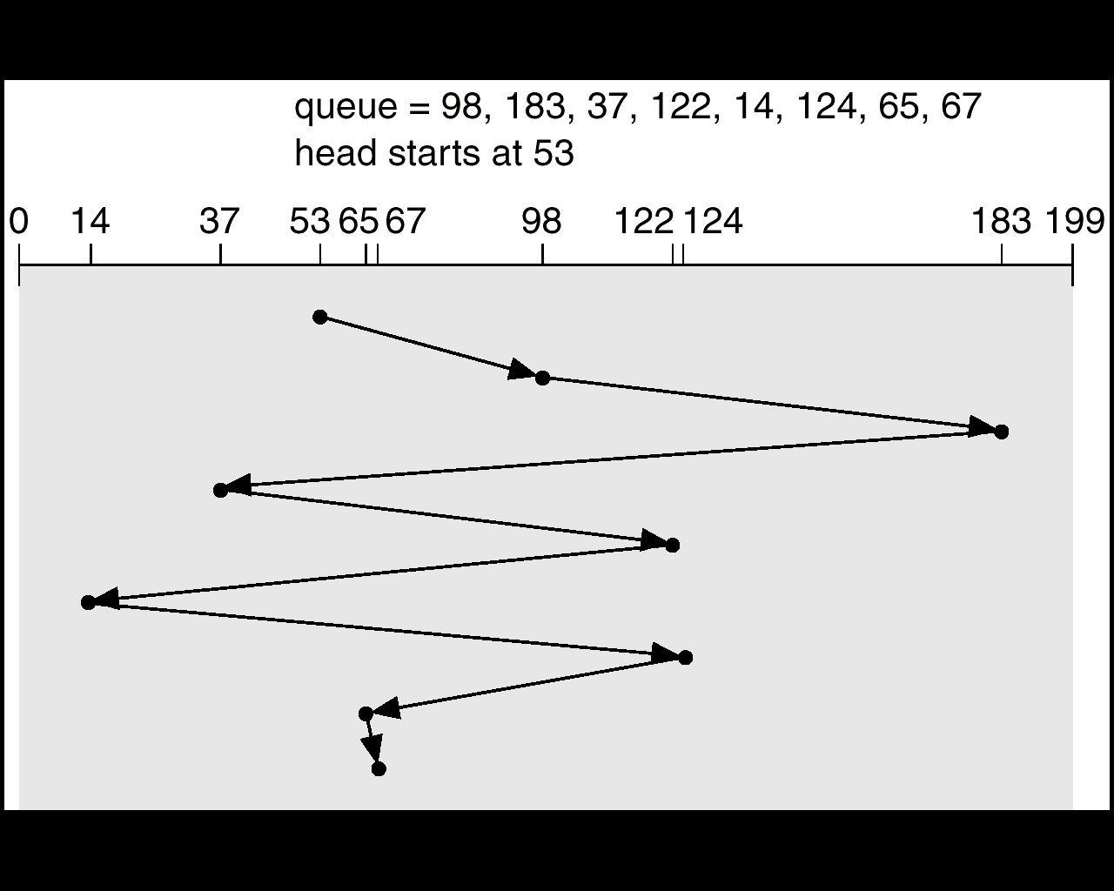
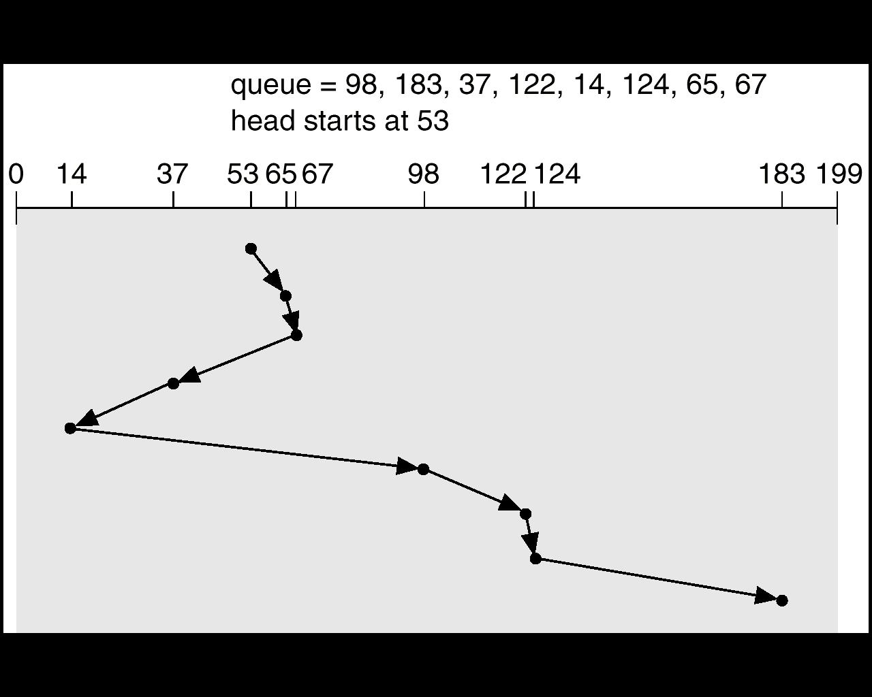
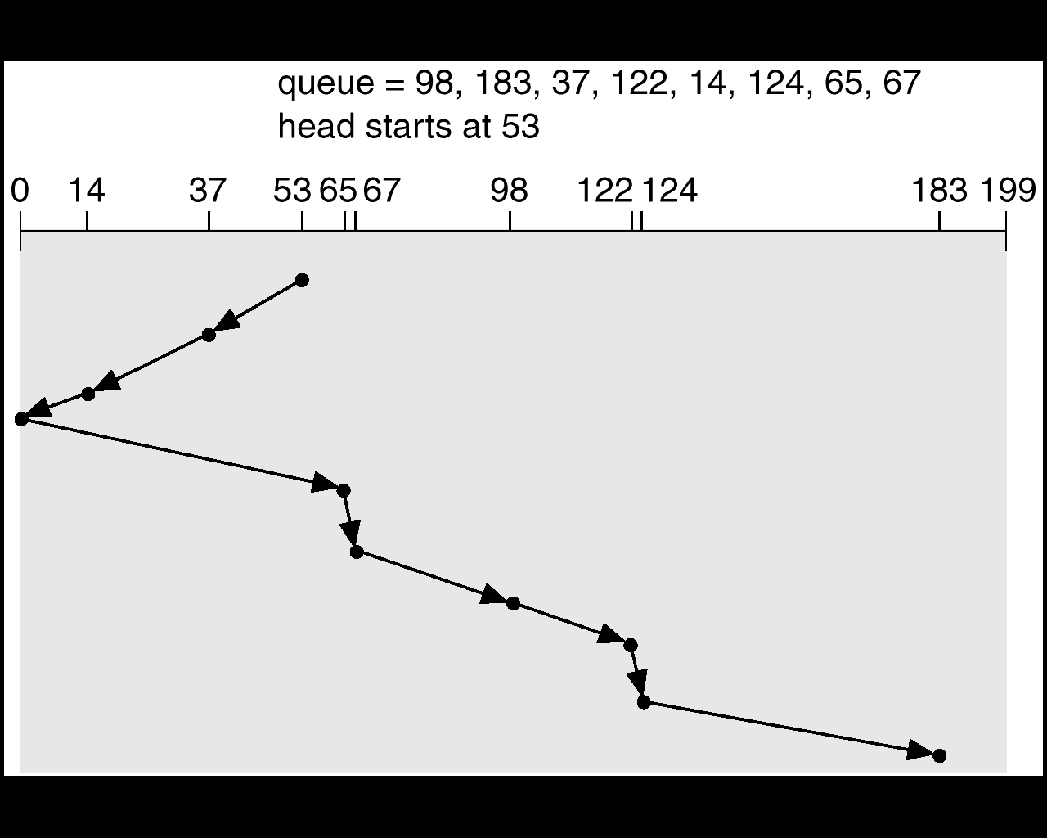
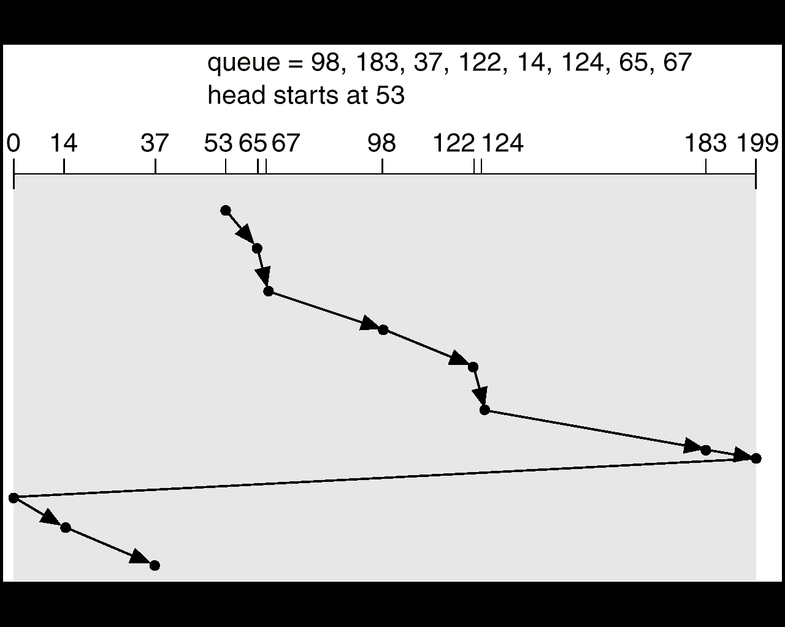
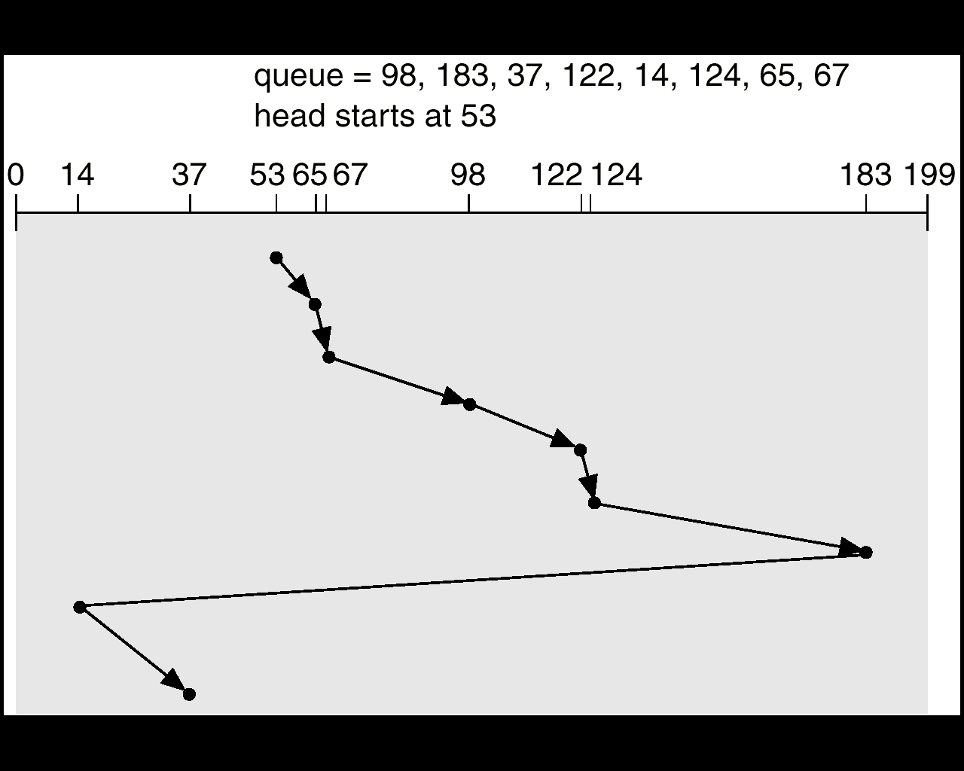
1. FIFO, Head Movement=640 cylinders
Operating System
Disk Scheduling Algorithms Examples
2. SSTF, Head Movement=236 cylinders
3. SCAN, Head Movement=236 cylinders
4. C-SCAN, Head Movement=382 cylinders
5. LOOK, Head Movement=299 cylinders
6. C-LOOK, Head Movement= 322 cylinders

Slide 8
Operating System
OS Security: Authentication, Access Control, Threats
Authentication-In a file system, authentication is used to verify the identity of a user or process before granting them access to files and resources. This process helps ensure that only authorized users can access sensitive information and perform specific actions on the file system.
Access Control-File system access control limits who can interact with files and directories, ensuring only authorized users have the necessary permissions. This is achieved through a variety of mechanisms, including permissions, access control lists (ACLs), and various access control models like discretionary access control (DAC) and role-based access control (RBAC).
Threats-File systems, the foundation of how operating systems store and manage data, are vulnerable to various threats that can compromise data integrity, availability, and confidentiality. These threats include malware, unauthorized access, and data corruption, all of which can have severe consequences for individuals and organizations.

Slide 9
Operating System
Phase 1 (Activity)
Q1. What is FLAT? Explain its significance.
Q2. Define NTFS file system.
Q3. What are disk scheduling algorithms?
Q4. List different types of disk scheduling algorithms.
Q5. What is the function of access control in OS?
Q6. Define the purpose of authentication in OS.
Q7. How file systems organize and manage files on storage devices?
Q8. Write the full forms of the FAT, NTFS and exFAT.
Q9. List different versions of FAT and what number represents in those versions?
Q10. Write the advantages and disadvantages of FAT.

Slide 10
Operating System
Phase 2 (Activity)
Q1. Write about the authentication in file system.
Q2. Write about the security in file systems.
Q3. Write about the access control in file systems.
Q4. Write about the access control list (ACL) in file systems.
Q5. Write about the threats and its types in file systems.
Q6. Write about the consequences of threats.
Q7. Write about the different security features.
Q8. Discuss the importance of File Access Control.
Q9. Discuss different types of threats.
Q10. Discuss about the different authentication methods.

Slide 11
Operating System
Phase 3 (Activity)
Q1. Which disk scheduling algorithm is best for high-performance servers?
Q2. Why two algorithms (SSTF and LOOK) are high performance based?
Q3. Why performance of FCFS, SCAN and C-SCAN are not as good as SSTF and LOOK?
Q4. Explain rotational latency concept and how it affects disk access time in different scheduling algorithms.
Q5. How does the number of requests in a queue affect the performance of LOOK and C-LOOK algorithms compared to SCAN and C-SCAN?.
Q6. What is starvation in the context of disk scheduling? Which disk scheduling algorithm is most prone to causing starvation? .
Q7. Why is disk scheduling algorithm needed?
Q8. Discuss important terms related to Disk Scheduling Algorithms.

Slide 12
Operating System
Phase 3 (Activity)
Q9. Consider a disk queue with requests for I/O to blocks on cylinders 98, 183, 41, 122, 14, 124, 65, 67. The FCFS scheduling algorithm is used. The head is initially at cylinder number 53. The cylinders are numbered from 0 to 199. The total head movement (in number of cylinders) incurred while servicing these requests is _______.
Q10. Consider an imaginary disk with 51 cylinders. A request comes in to read a block on cylinder 11. While the seek to cylinder 11 is in progress, new requests come in for cylinders 1, 36, 16, 34, 9, and 12, in that order. Starting from the current head position, what is the total distance (in cylinders) that the disk arm moves to satisfy all the pending requests, for each of the following disk scheduling Algorithms? 1. FCFS (First come first serve), 2. SSTF (Shorted seek time first), 3. SCAN, 4. C-SCAN, 5. LOOK (Elevator), 6. C-LOOK.

Slide 13

Operating System

